Slide 1


Hospital Management System
Submitted by,
Arvindharaj P
Pranav Gurram
Nikita Suryawanshi
Guided by ,
Mrs. Pavitra

Slide 2

Introduction
Hospital Management System is the System where all the aspects related to the Hospital is done.
These aspects involves Managing information about the Patient , Doctor, Receptionist , Admin ,Booking appointments, Billing etc.
This system provides an efficient way of managing the Hospital in formation.

Slide 3

Abstract
Hospital Management System is an organized computerized system designed and programmed to deal with day-to-day operations and management of hospital activities.
The program can look after patientsAdmit, patientsDischarge, Booking appointment, patients status, patient billings, It also maintains hospital information such as ward id, doctors in charge, and department administering.

Slide 4
Modules
Admin Module.
Patient Module.
Doctor Module.
Receptionist Module.
Payment Module.
Prescription Module.
Room module.
Booking Appointment module.

Slide 5

Software Requirement
Back-End:
Spring Core. Spring Boot, Rest API, Java Persistence API and Hibernate.
postman
Database:
MySQL

Slide 6

Hardware Requirement
Windows 10 or above.
RAM: 4GB or above.

Slide 7
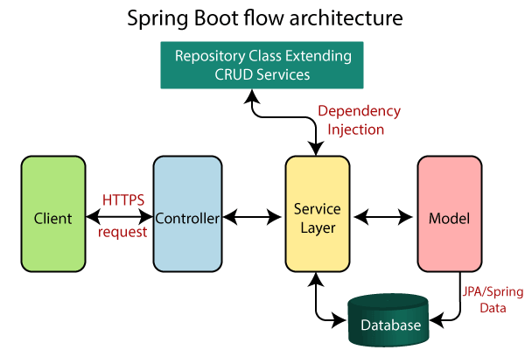
What is spring boot?
Java Spring Boot (Spring Boot) is a tool that makes developing web application and microservices with Spring Framework faster and easier through three core capabilities:
Autoconfiguration
An opinionated approach to configuration
The ability to create standalone applications

Slide 8
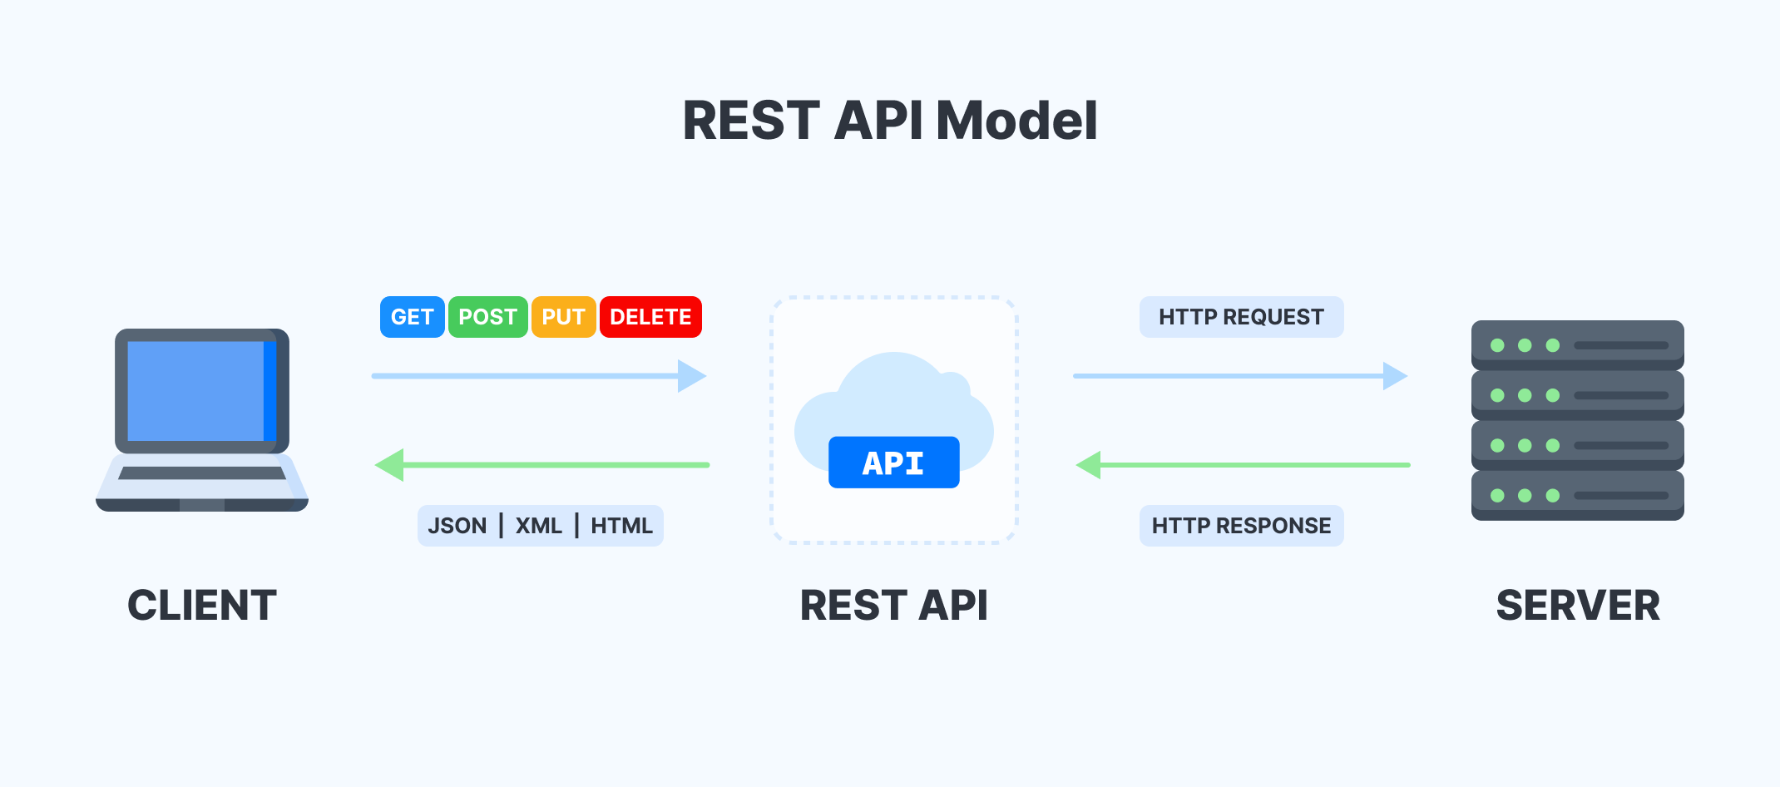
What is Rest API ?
Representational State Transfer (REST) is an architectural style that defines a set of constraints to be used for creating web services.
REST API is a way of accessing web services in a simple and flexible way without having any processing.

Slide 9
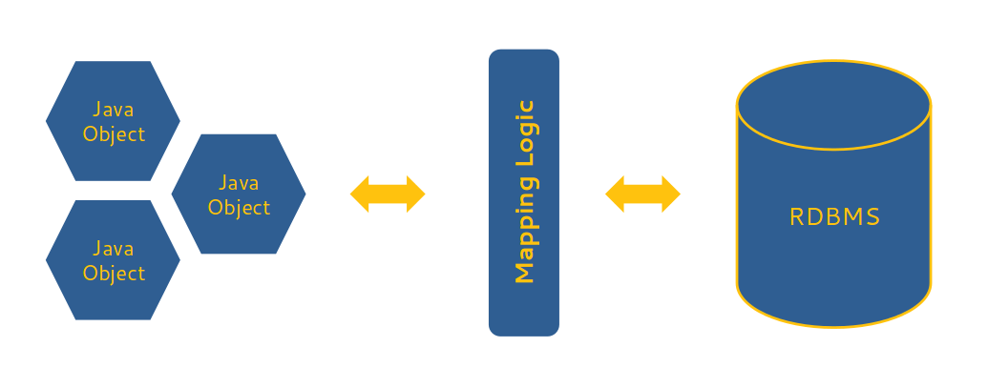
Java Persistence API ?
A JPA (Java Persistence API) is a specification of Java which is used to access, manage, and persist data between Java object and relational database.
It is considered as a standard approach for Object Relational Mapping.
JPA can be seen as a bridge between object-oriented domain models and relational database systems.

Slide 10
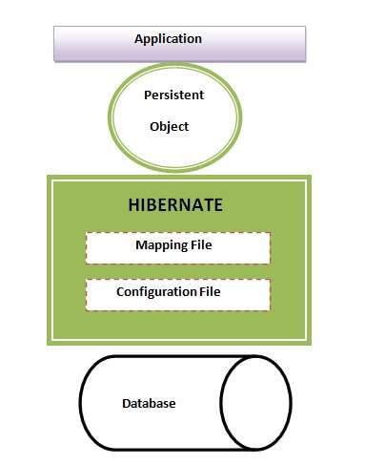
Hibernate ?
Hibernate is an Object-Relational Mapping (ORM) tool which is used to save the state of Java object into the database.
It is one of the most frequently used JPA implementation.
It is defined in org.hibernate package.

Slide 11
Postman ?
Postman is an application used for API testing.
It is an HTTP client that tests HTTP requests, utilizing a graphical user interface, through which we obtain different types of responses that need to be subsequently validated.
Postman is an application that allows us to test APIs utilizing a graphical user interface.

Slide 12


UseCase Diagram
Give counselling
Doctor
Managing Profile
Login
Receptionist
Checking History
Billing
Patient
Checking History
Edit Receptionist/Doctor
Admin
Managing Patients
Allocating Rooms
Booking Appointments
Add Receptionist/Doctor
Remove Receptionist/Doctor

Slide 13
Er Diagram
Contact number
age
specialization
name
patientId
Medical
Background
EmailId
Blood group
doctorId
Doctor
age
passward
name
counselling
Patient
manages
name
Contact number
Book
age
gender
Does
manages
Admin
gender
BillNo.
check
receptionist
PatientId
Payment
EmailId
address
name
Contact number
Doctor Charges
Contact number
Payment Type
AdminId
gender
Payment status
receptionistId
Room charges per Day
age
EmailId

Slide 14
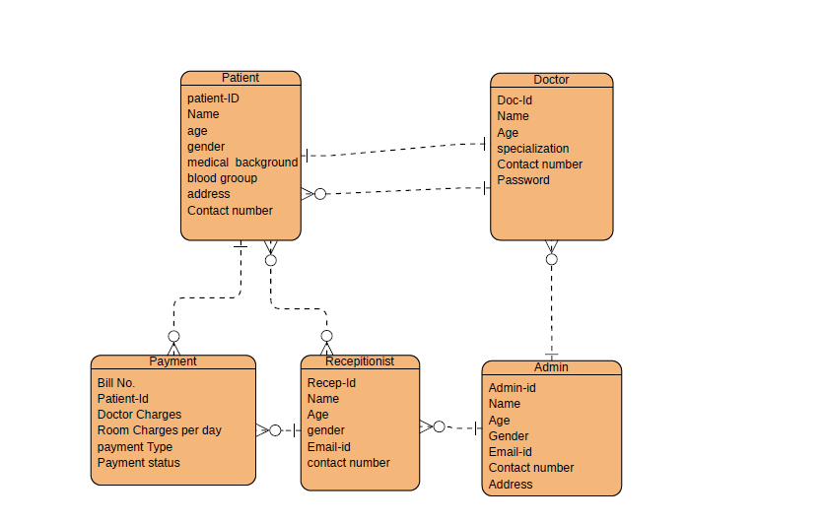
Class Diagram

Slide 15
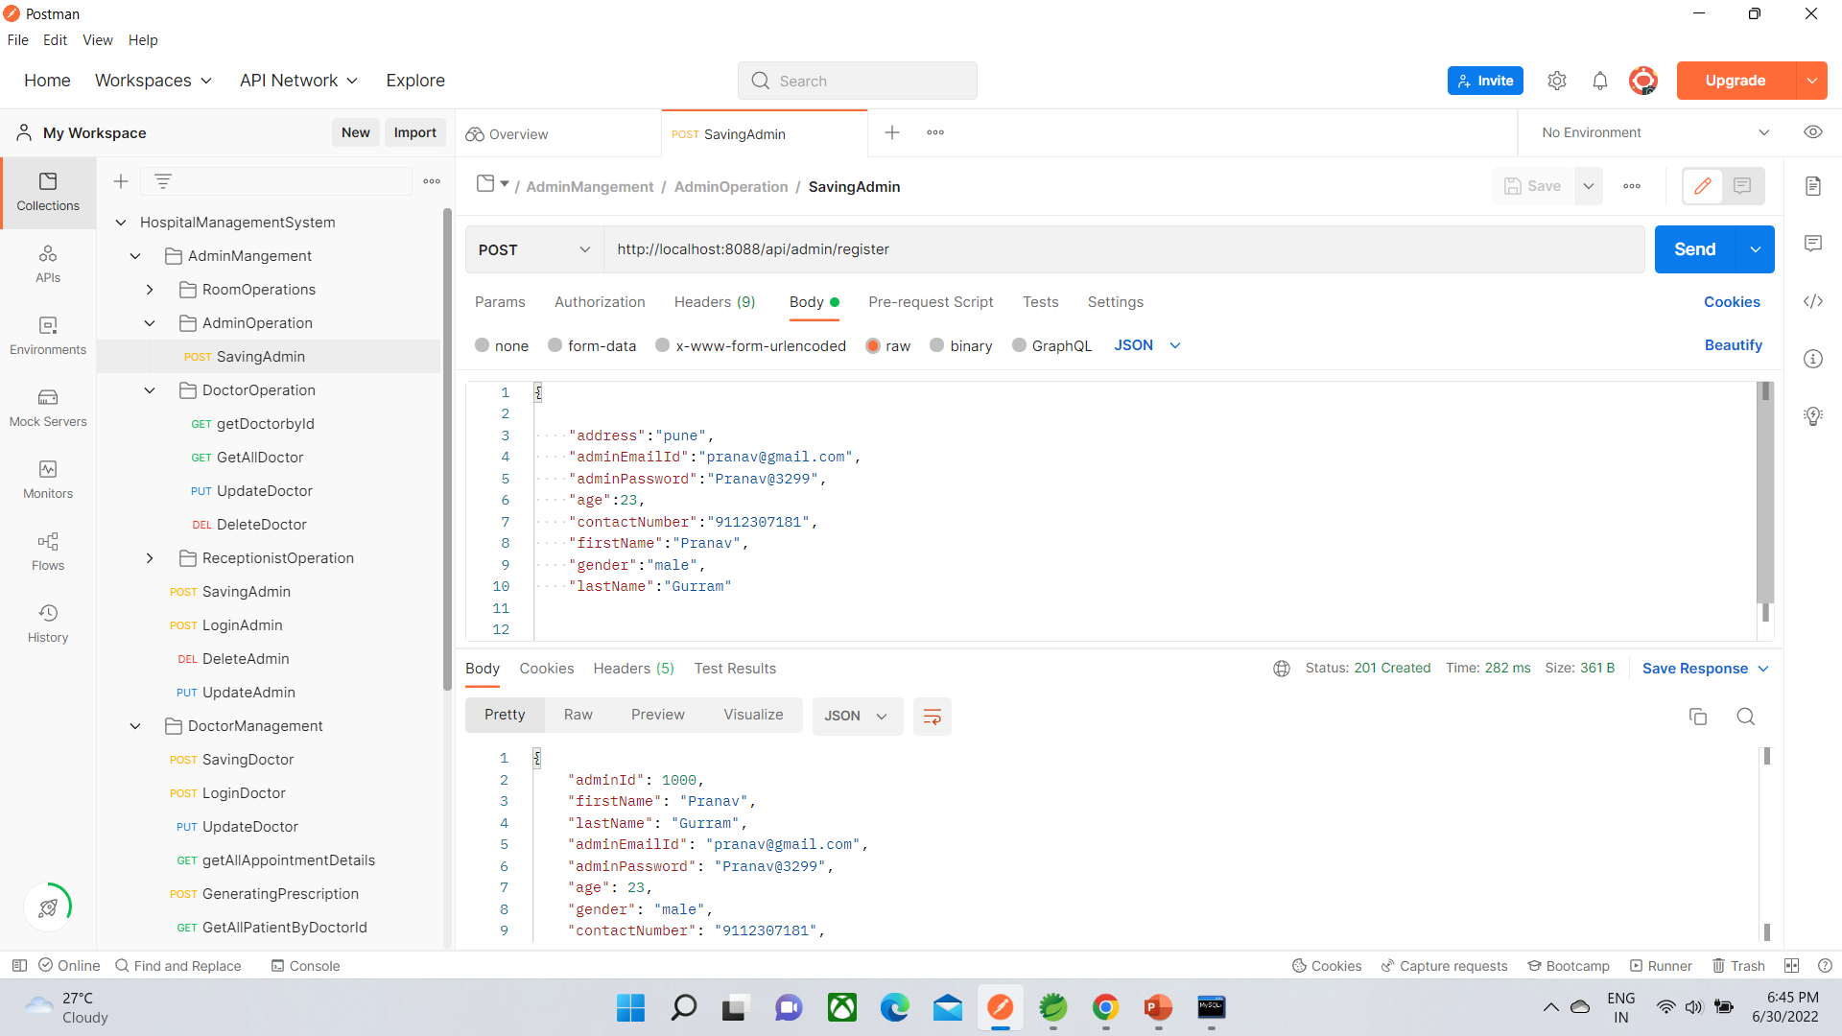
Output on Postman

Slide 16
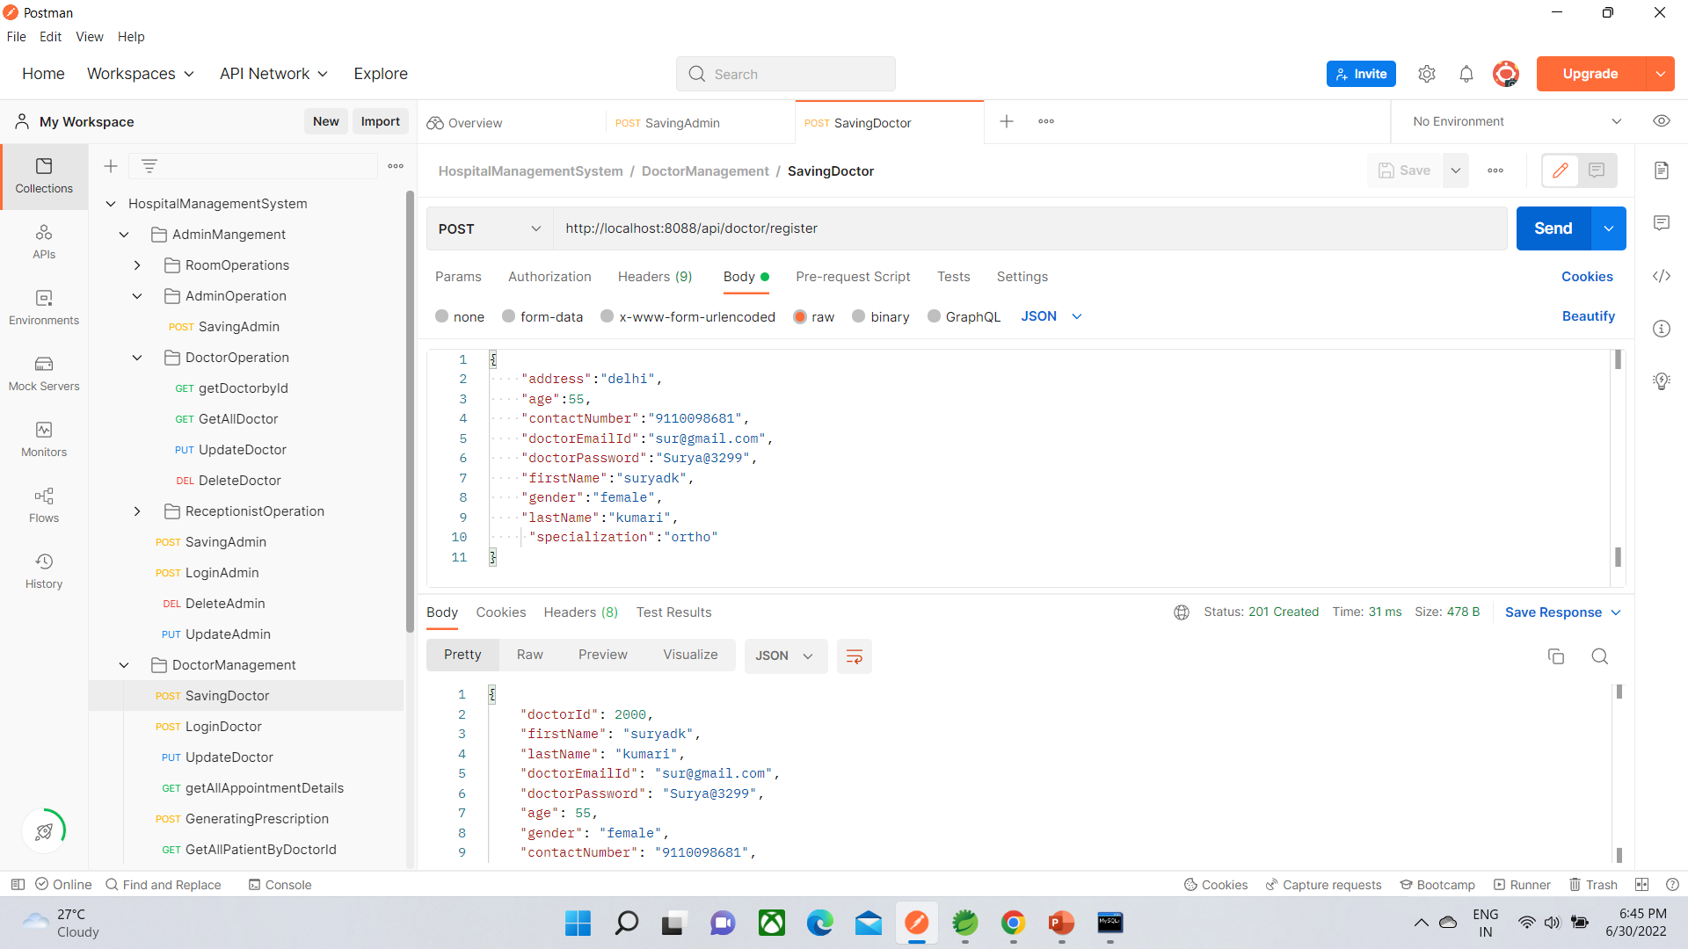
Output on Postman

Slide 17
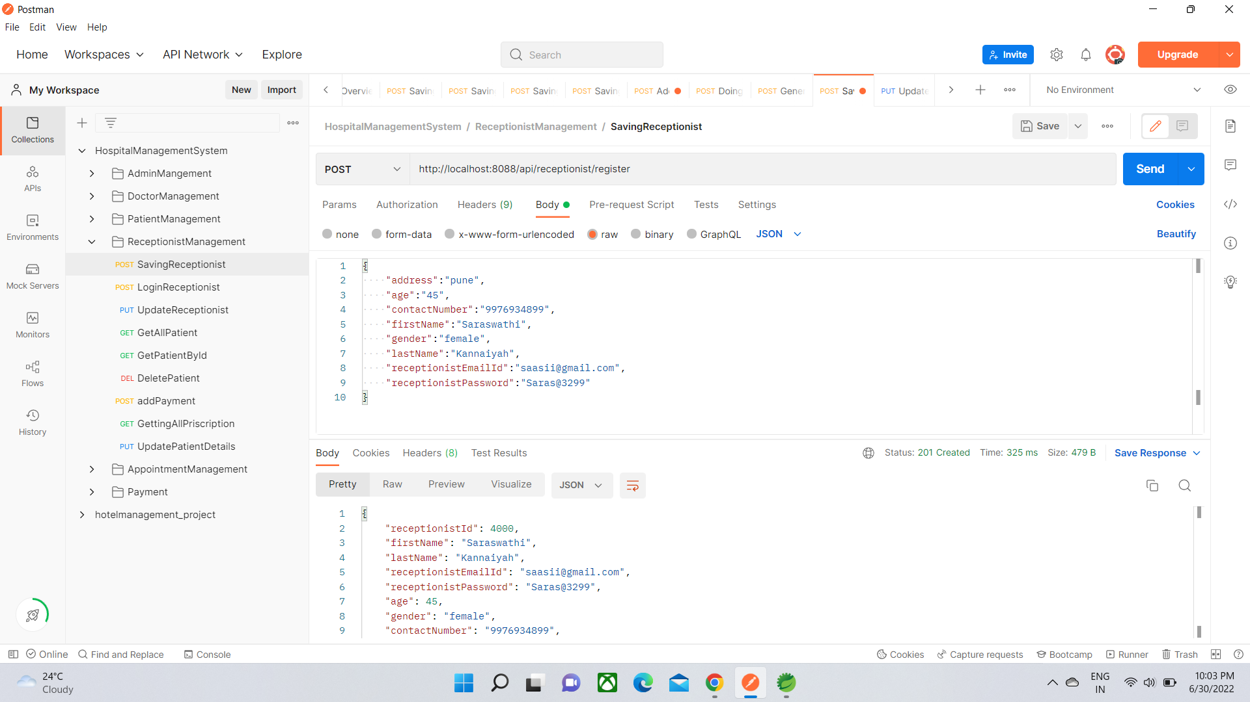
Output on Postman

Slide 18
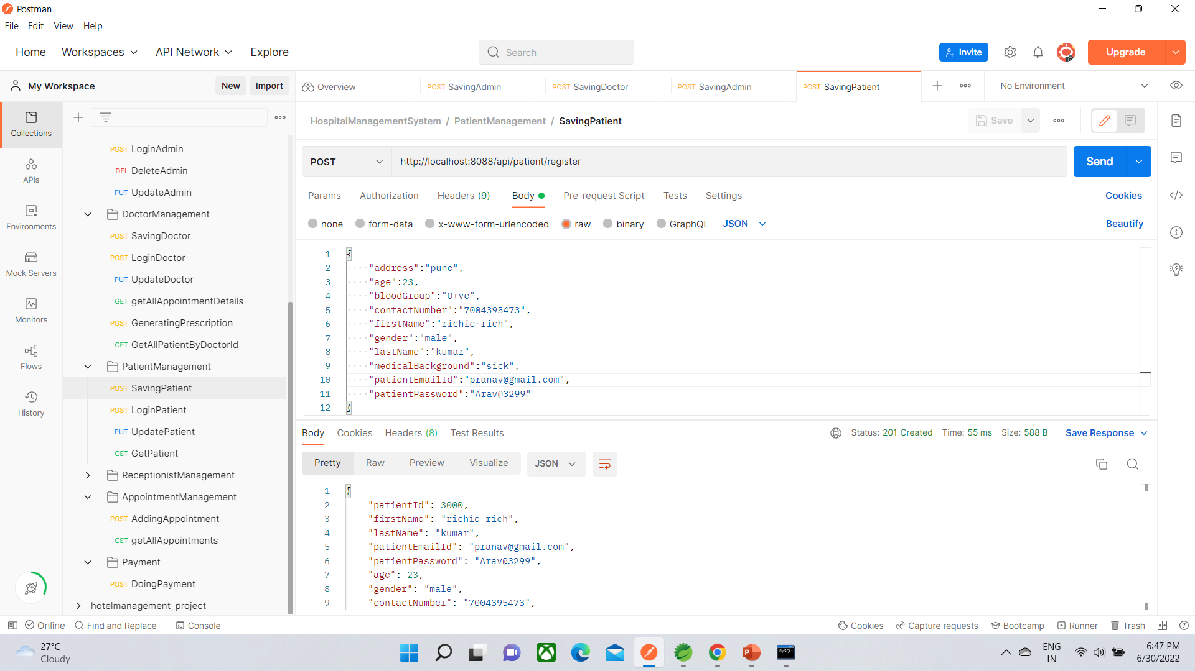
Output on Postman

Slide 19
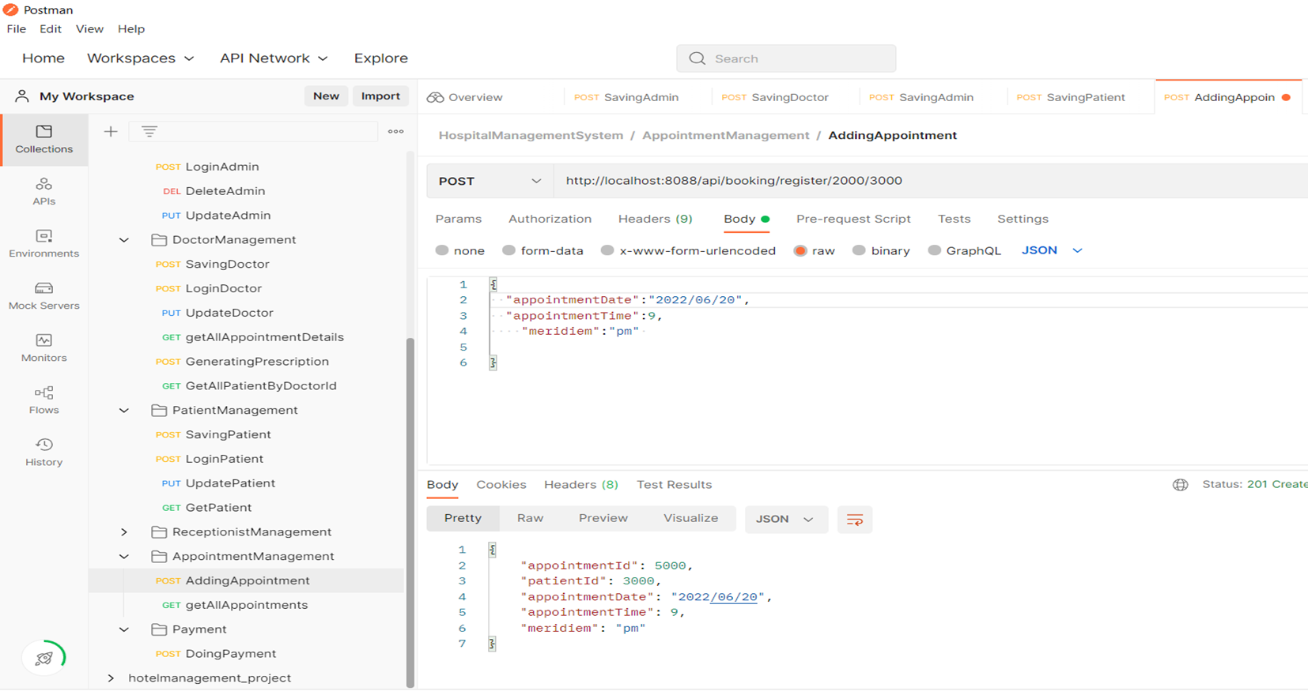
Output on Postman

Slide 20
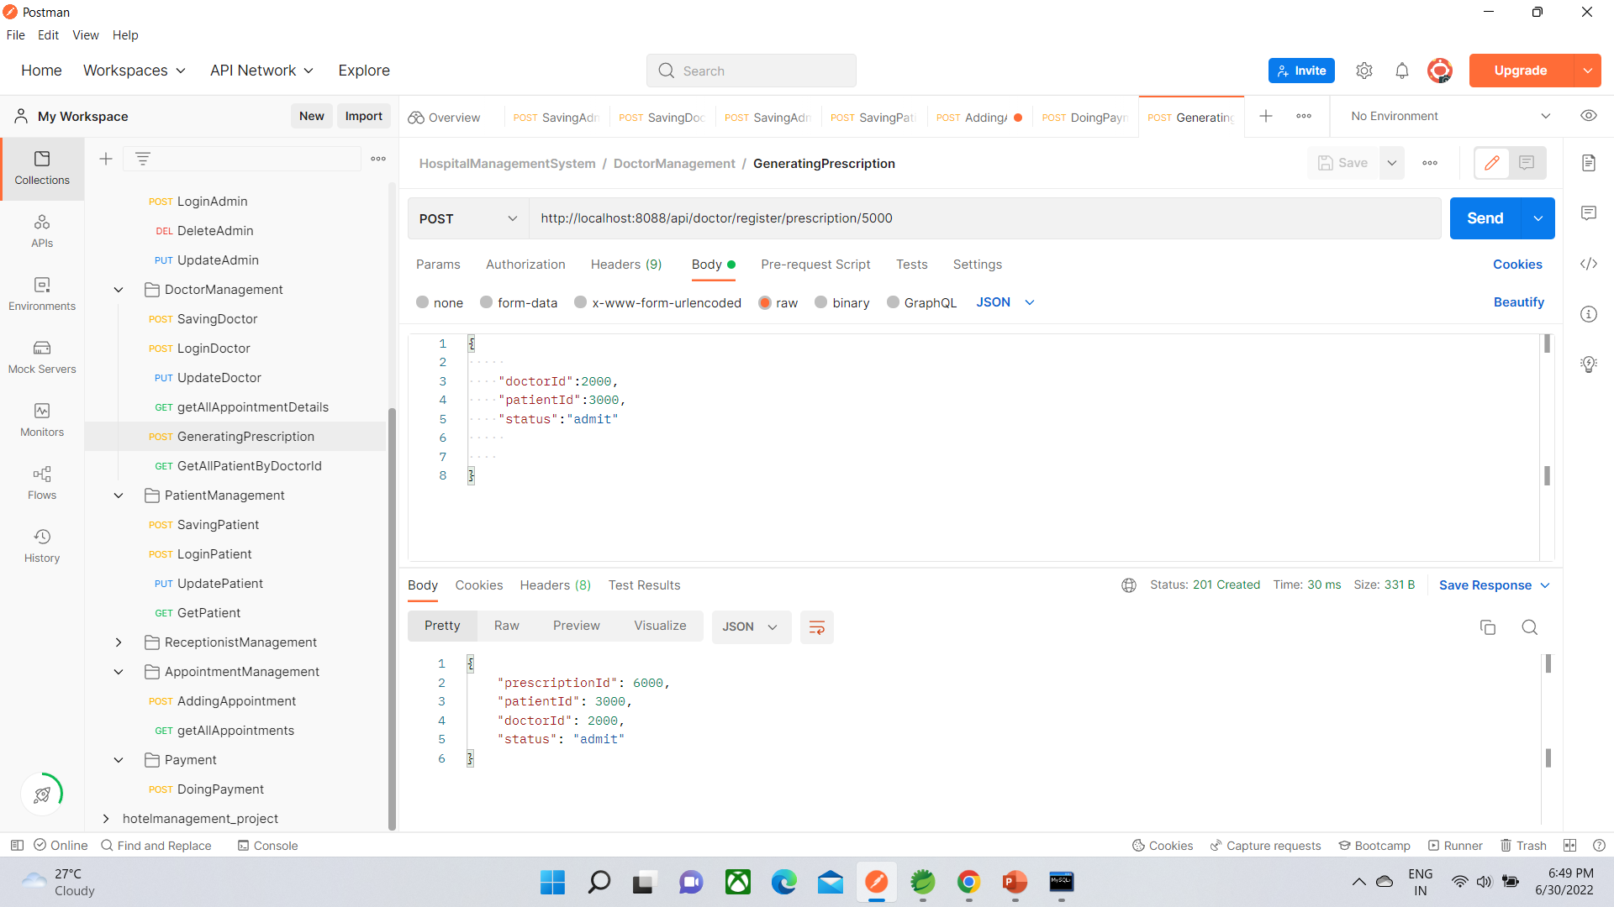
Output on postman

Slide 21
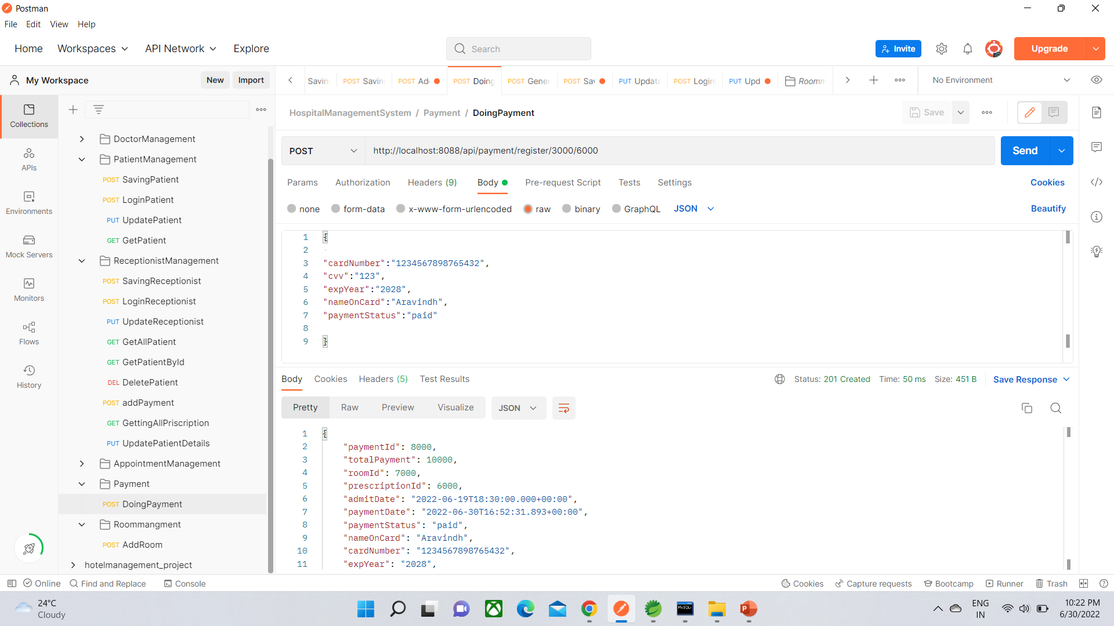
Output on Postman

Slide 22
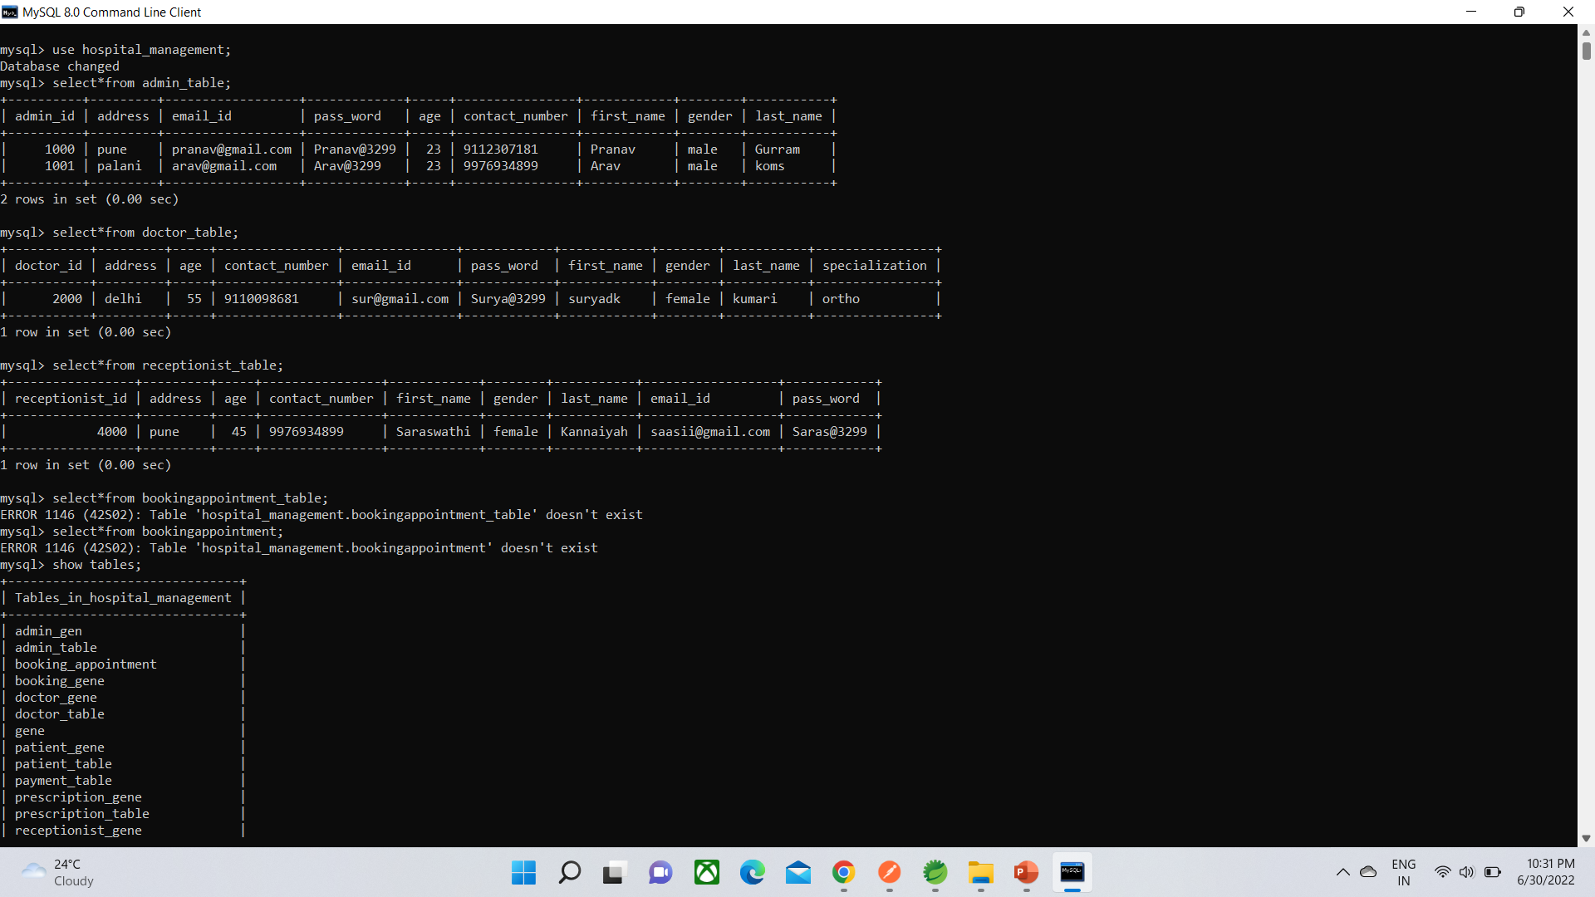
Output of Database

Slide 23
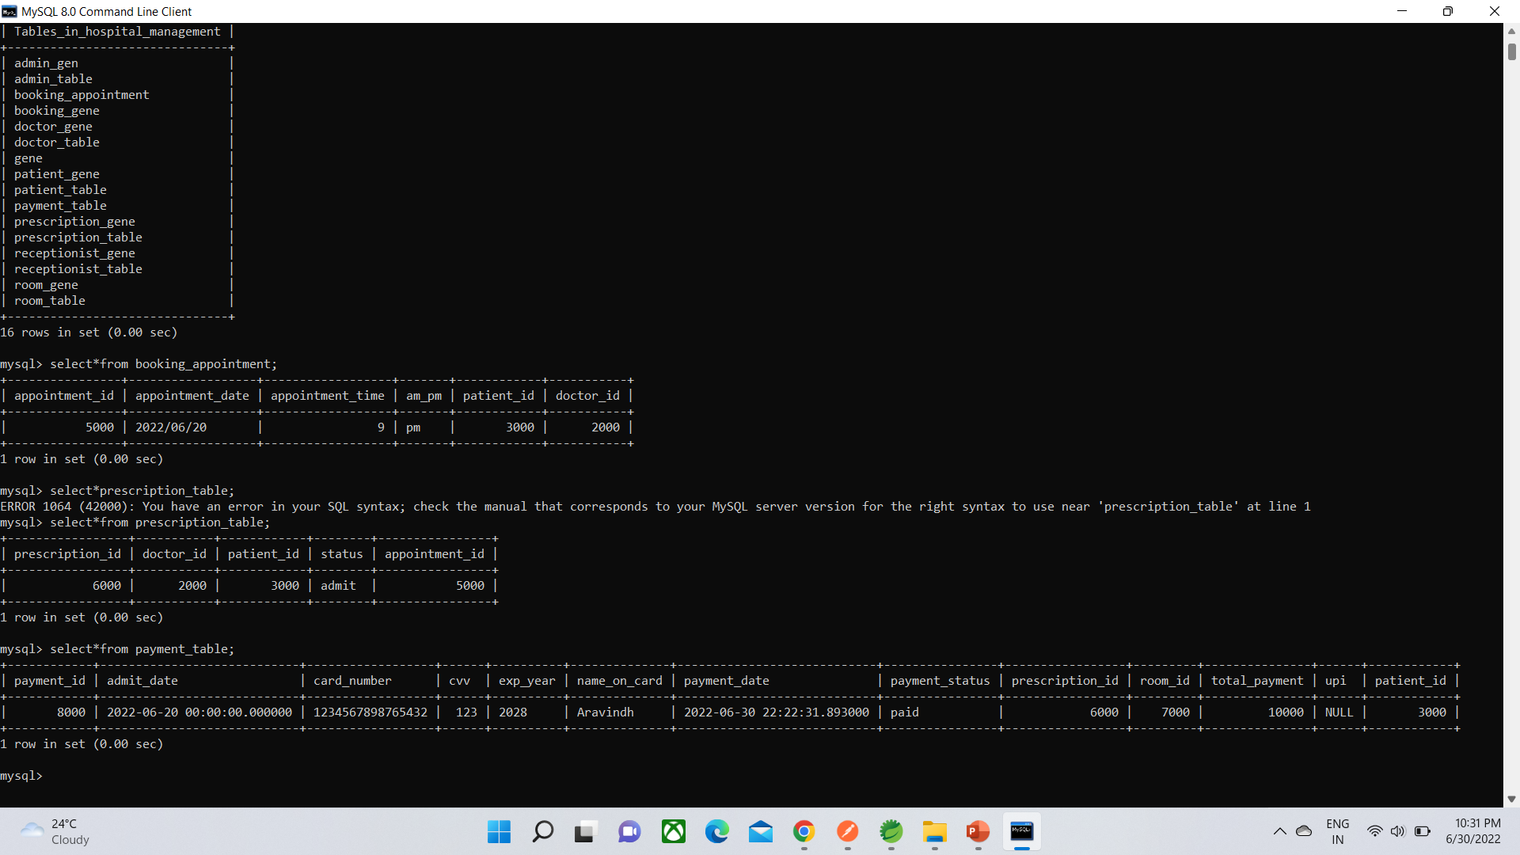
Output of Database

Slide 24
Future Scope
We can enhance this system by including more facilities like pharmacy system for the hospital, Health policies , medical test etc.
We can enhance this system by adding the bill generation and validation.

Slide 25
Conclusion
By implementing this Hospital Management System we are getting the more flexibility for the
Users.
Which can make easy to handle all operation done in hospital management System like booking appointment, adding patient ,adding doctors etc. patient can check profile and update there information using login. Doctor also can access all patient details that’s appoint to particular doctor.

Slide 26
Reference
https://www.w3schools.com/java/
https://www.javatpoint.com/spring-boot-tutorial
https://www.apollohospitals.com/

